Slide 1
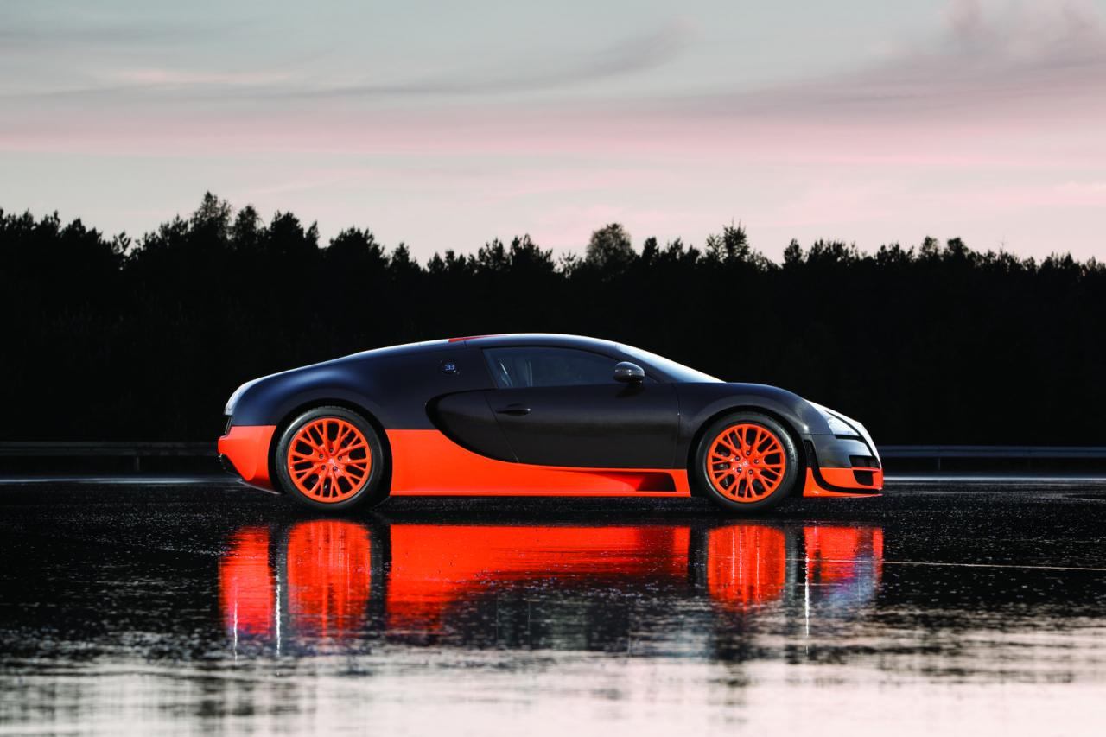
My 20% Project
By: Ricardo Dime

Slide 2
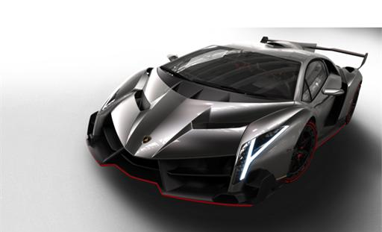
Challenge
What I am doing for my 20% Project is making a prototype on a sports car. How will this be challenging… well that’s the biggest question. The challenge here, is not only making the exterior, not only making stuff pretty, witty, and gritty. I also have to use other ideas already implemented into other cars, race cars, and hope to piece together my own sports car, and some day make it into a reality.

Slide 3
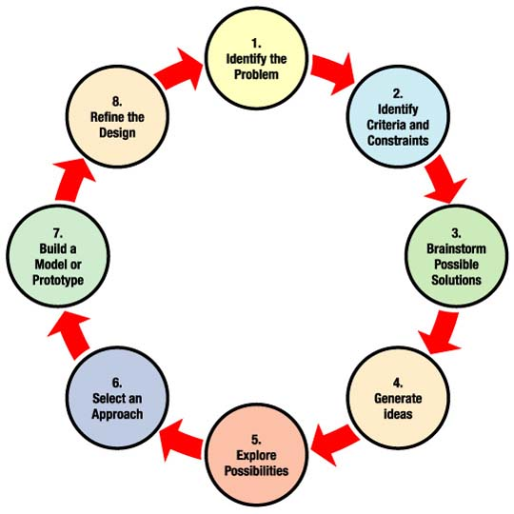
Learning
What I would expect to learn is how to use the Engineering Design Process into this project. That would be important because anything in that is involved with gears, nuts and bolts, it all some how got involved into the EDP.
Another thing I will learn is how cars today work, and how I can use other successful cars’ implemented ideas to make my car that I will be making, just as successful.

Slide 4
Learning Cont.
So more on how I will use today’s modern cars’ implemented ideas… Well its more than making the exterior sharp, and looking nice. Its what’s inside of our vehicles that we don’t get to appreciate or take mind until we see it destroyed. So I will be learning on how engines work, the transmission, and also the suspension that gives the motor vehicle stability and grip either on a track or on a road.

Slide 5
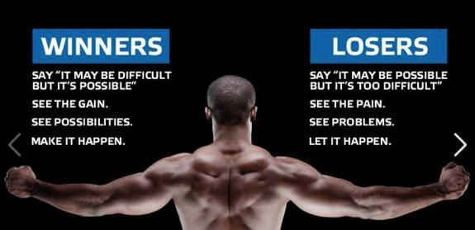
Motivation
So the biggest motivation for this project is not on how I love sports cars, race cars… it’s how I got to love what I love today and hopefully the rest of my life.
I’ll tell you more about it…

Slide 6
Materials
For this project all I will be using is a bunch of paper and pencils. Until I will be using clay to find the aero dynamics of my vehicle and hope to make it better.
Materials Needed to buy:
-Clay
-Card Board or Foam
-Carving Utensil

Slide 7
Design Process
Link For Design Process:
http://worldwide.hyundai.com/WW/Innovation/Design/DesignProcess/index.html
I will show progress by posting on Edmodo what I have done so far or using any applications Ms. Garcia will provide.

Slide 8
Time
Well time is what any prototype would need really, you can only do so much as a person. As far as getting the prototype, clay model, and measurements. My guess picturing me finished with this project is February-March. Which could be moved up even months ahead, but I should give updates for this project due date.
Projected Due Date:
February 21 Or March 14

Slide 9
Resources
I will compile all my inspirations, sources, and pictures, into one. But as far as a mentor. I do not have a mentor, or any help towards this. I believe I could take this to another level and make my dreams as a car designer to a reality in the future but if I have help today I could show great passion, enthusiasm, and great focus… \
A lot of people young, and old probably went through a bunch of drawings of prototypes, and clay models, but at the same time I am jumping into my first experience of what I will want to do for the rest of my life, as a career, but why not start now. I want to complete Prototype Drawings (exterior and interior), engine lay out and drawings, clay model, and price estimate.

Slide 10
Difficulties
Alright the fun already started for me with prototype drawings and a lot of thinking about this. But believe it or not sometimes the most fun things that I might think would be cool will actually be hard. So what I think are going to be hard are:
-Measurements
-Clay Modeling
-Price Estimation
Why I Think the following are going to be hard is because, I never really got to do this, actually not even get to think about this. So a lot of new things that I will be learning will also help me develop as a car designer, and as a student.

Slide 11
Sharing
I will share my experience is actually showing people how to make a sports car. How to show my learning from this project is teaching people what I have learned. My target audience is basically people who actually have the passion for design, drawing, or a love for motor vehicles.
High or low we all got to start from some where. So why not start now?

Slide 12
Evaluation
How I think this project should be evaluated is simple. I think when I am finished with my project, I should present what I have finished, and show prices of the vehicle’s expected price and see if people would actually consider buying the vehicle or invest their money into something else. But I am also looking for feedback from everyday people because as an 8th grader in middle school I only know so much on what I like and what I want to see in things I buy but you don’t really think about things when other people are going to be involved in. So buyers interest, and feed back is how I think this should be evaluated.

